Slide 1
Polyimides
Dr.widad Salih

Slide 3
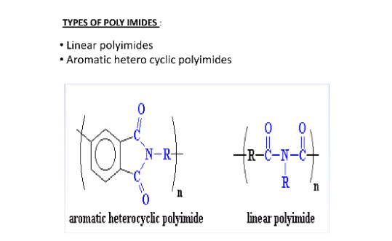

Slide 4
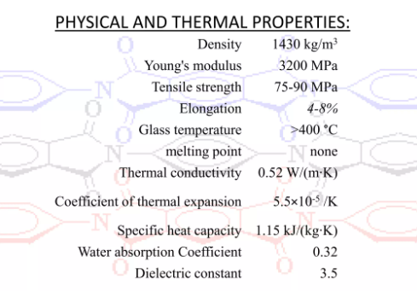

Slide 8
Synthesis of Polyimides

Slide 9
Polyimides are polymers incorporating the imide group in their repeating unit, either
as an open chain or as closed rings. However, only cyclic imides are actually of interest
concerning polymer chemistry
In a list of applications of polyimides, the following should be included:
Insulating films, coatings and laminates
Molded parts
Structural adhesives
Insulating foams
High-modulus fibers
High-temperature composites
Perm selective membranes

Slide 10
There are two steps to preparation of polyimides , first formation of polyamic acid ,second convert polyamic acid to polyimides via cyclodehydration reaction

Slide 11
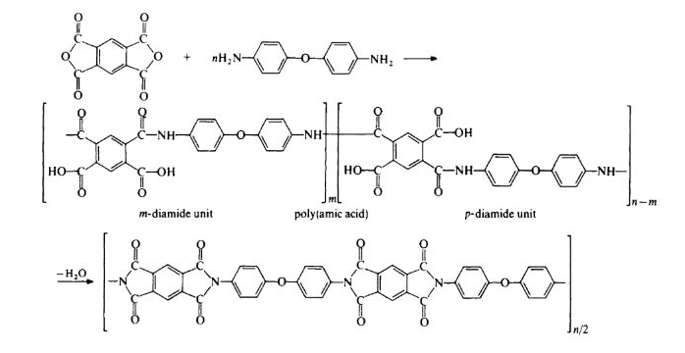

Slide 12
Synthesis of Polyimides
1- from dianhydride with diisocyanate
2- from diimides with dihalides

Slide 13
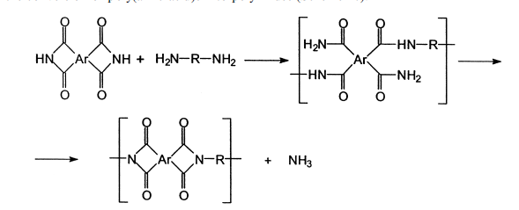
This reaction is accompanied by the separation of hydrogen halide, so that an acid
acceptor is needed to catalyze the reaction, which is carried out in polar solvents at high
temperature [115]. Aromatic dihalides are not suitable reactants for this reaction, unless
activated dihaloaromatic monomers are used .
3- Aminolysis of diimides with diamines

Slide 14
4- Transimidization

Slide 15
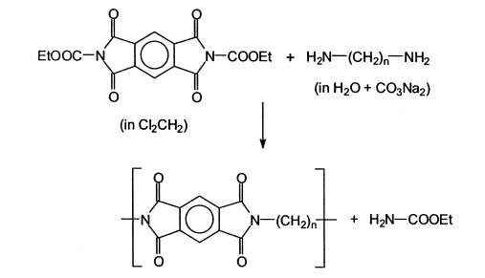

Slide 17
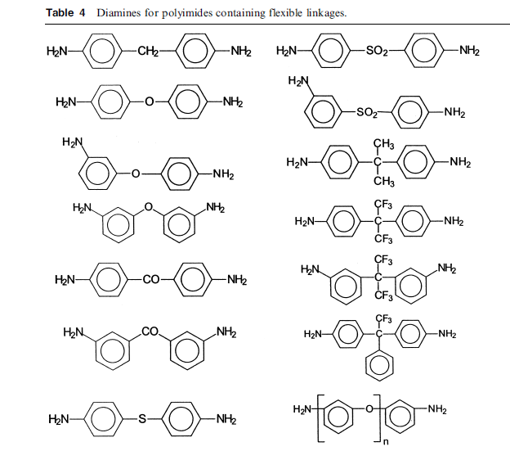

Slide 18
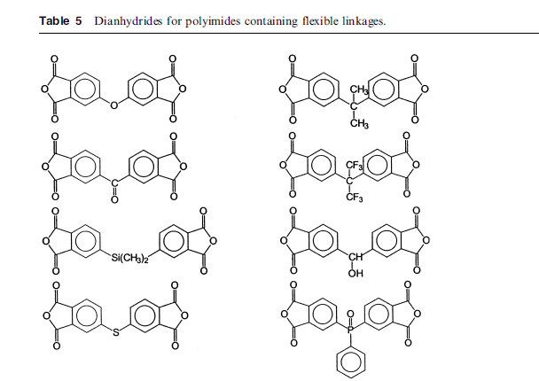

Slide 19
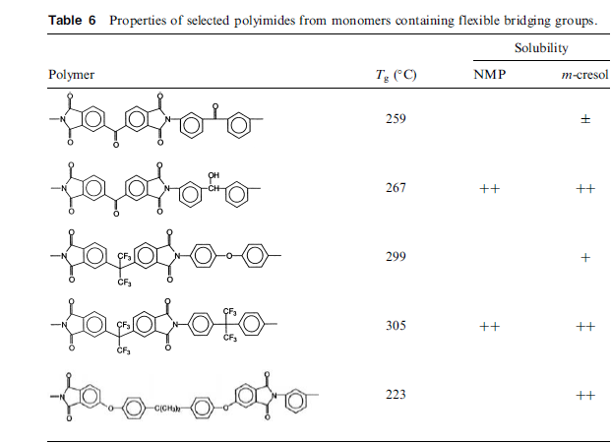

Slide 20
One-step Polycondensation. Thermoplastic Polyimides
As mentioned before, the first generation of fully aromatic homopolyimides, could be used
only in a few application because they had to be applied in the form of soluble polygamic
acids, what limited the materials to be transformed almost exclusively into films or
coatings. They all had to be synthesized by a two-step method.
polypyromellitimides. Molecular stiffness, high polarity and high intermolecular association
forces (high density of cohesive energy) make these polymers virtually insoluble in any
organic medium, and shift up the transition temperatures well over the decomposition
temperatures. Thus, the strategies to novel processable aromatic polyimides have focussed
on chemical modifications, mainly by preparing new monomers, that provide less
molecular order, torsional mobility and lower intermolecular bonding
From the various alternatives to design novel processable polyimides some general
approaches have been universally adopted:
Introduction of flexible linkages, which reduces chain stiffness.
Introduction of side substituents, which helps for separation of polymer chains
and hinder molecular packing and crystallization.
Use of 1,3-substituted instead of 1,4-substituted monomers, and/or asymmetric
monomers, which lower regularity and molecular ordering.
Preparation of co-polyimides from two or more dianhydrides or diamines.

Slide 21
Many different linkages have been introduced with these purposes, but the most
promising are: –O–, C¼O, –S–, –SO2–, –C(CH3)2–, –CH2–, –CHOH–, and –C(CF3)2–.
These bonding groups may be located on the dianhydride, on the diamine or on both
monomers, or they can even be formed during the polycondensation reaction
From the various alternatives to design novel processable polyimides some general
approaches have been universally adopted:
Introduction of flexible linkages, which reduces chain stiffness.
Introduction of side substituents, which helps for separation of polymer chains
and hinder molecular packing and crystallization.
Use of 1,3-substituted instead of 1,4-substituted monomers, and/or asymmetric
monomers, which lower regularity and molecular ordering.
Preparation of co-polyimides from two or more dianhydrides or diamines

Slide 22
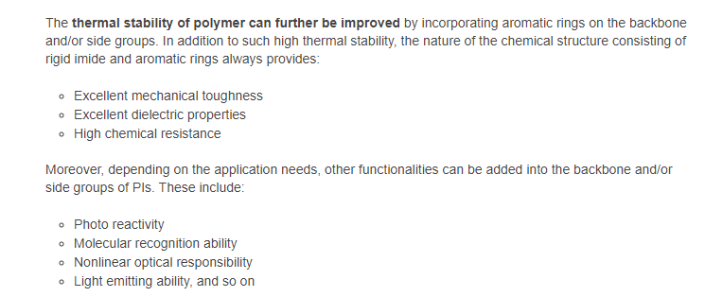

Slide 23
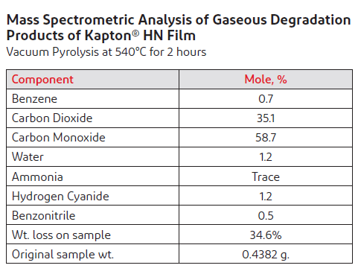

Slide 24
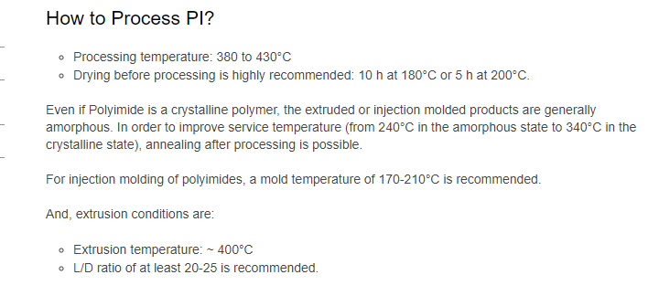

Slide 25
Q: Give an example of thermoplastic polyimides?

Slide 26
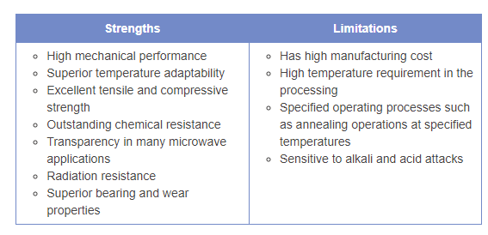

Slide 29
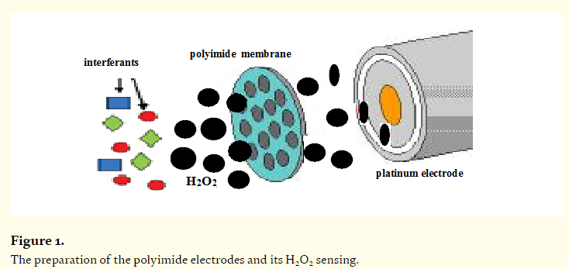

Slide 30
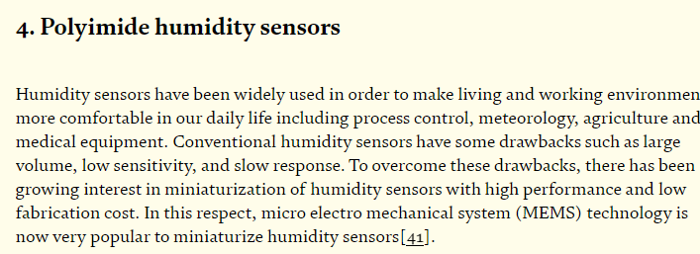

Slide 31
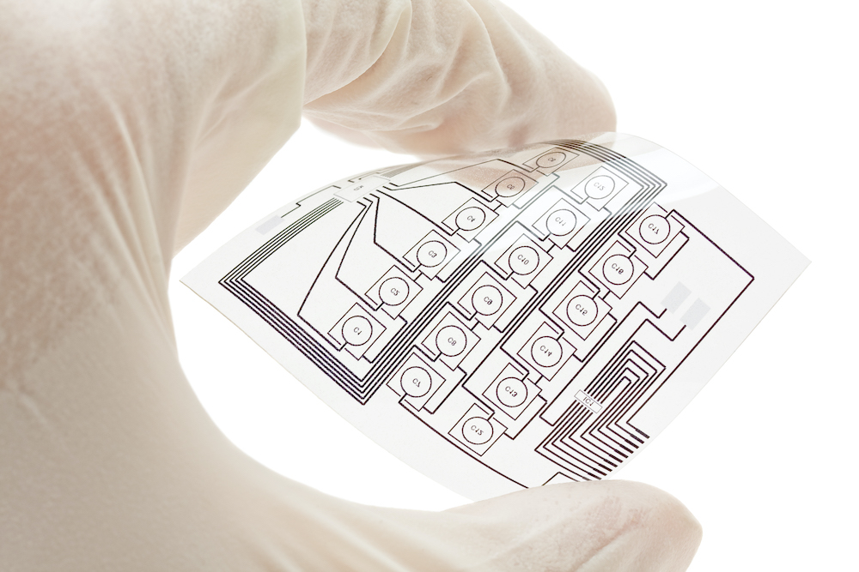
Polyimide is used as a substrate for flexible electronics and flexible solar cells.

Slide 32
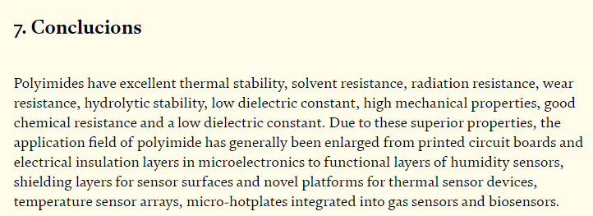
Conclusion

